Slide 1

Data Visualization + Storytelling
Nadav Rindler nrindler@gmail.com
MaGIC: Fast Business Insights with Data
30 Oct 2017

Slide 2
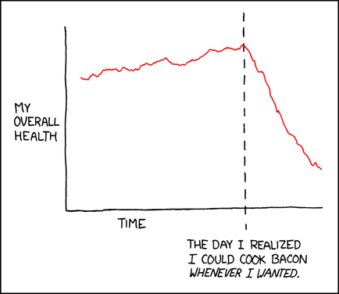


Workshop Format
1 minute: Humor
60 minutes : Introduction & demo
120 minutes : Hands-on exercise

Slide 3
Objectives
Understand frameworks to use visualizations to explore and explain data
Appreciate impact and value of storytelling
‘Best practices’ in visualization and storytelling
Be able to explain key concepts of data visualization
Give constructive critiques on infographics
Practice creating charts in Python

Slide 4

Context: Data science in action
Image: R for Data Science textbook

Slide 5
Key takeaways from today
Data visualization is an iterative process used to explore and explain data and insights
The point of data science is to impact decision-making and drive change. Visualization and storytelling are powerful ways to communicate and persuade.

Slide 6
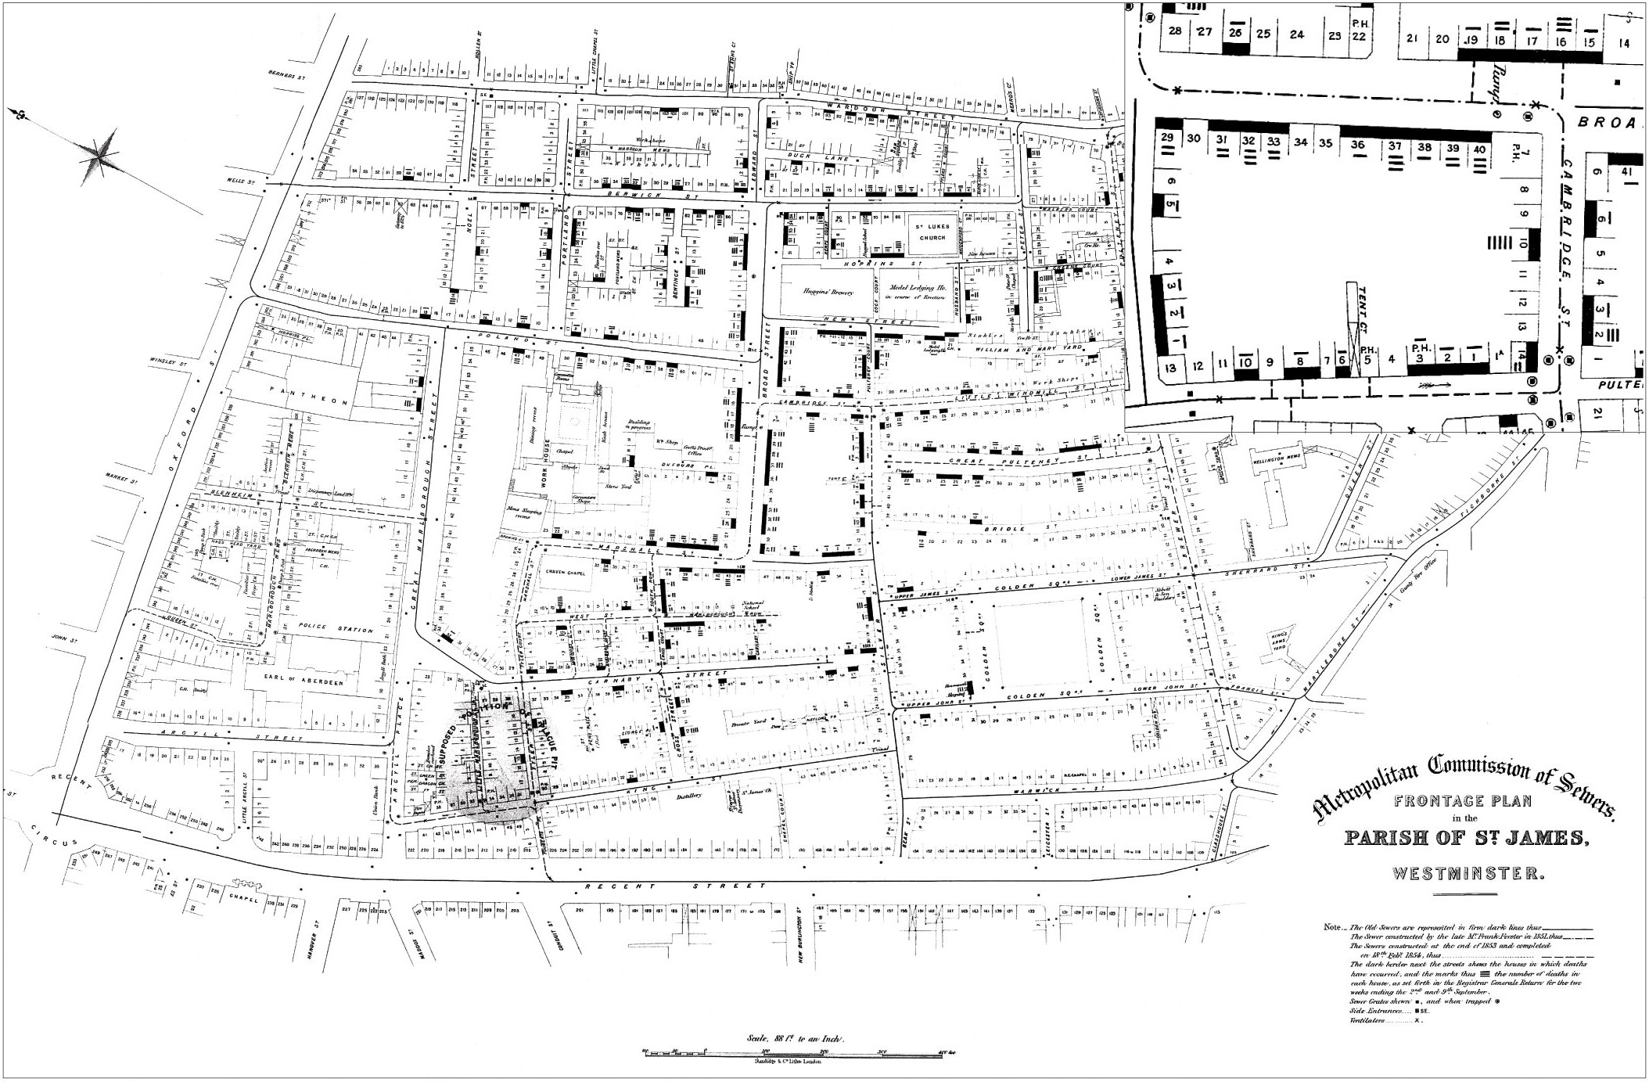
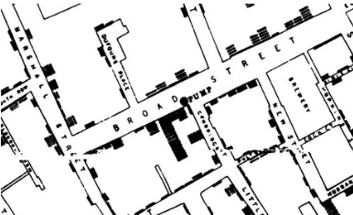
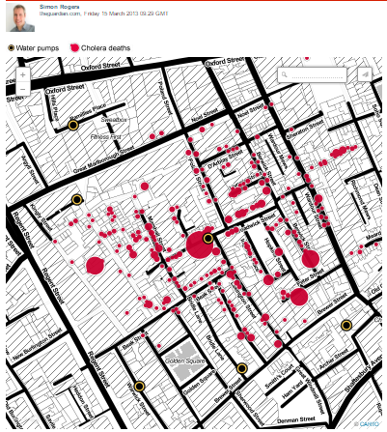
The cholera map that changed the world
Message
Countered belief mysterious cholera outbreak due to air-borne.
Visualization shows outbreak cases clustered around a pump, prompting examination of water supply
Impact
Change awareness & contain public disease spread

Slide 7
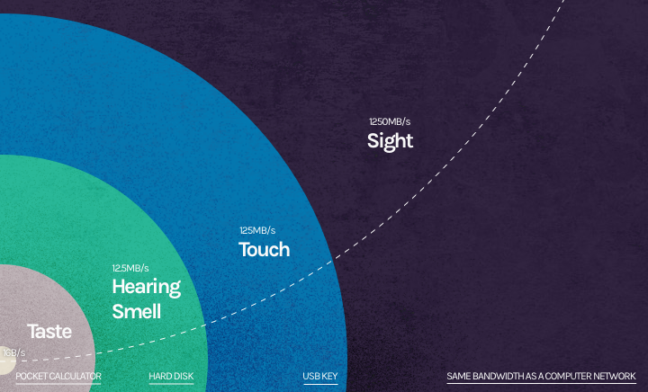
Why visualize?
Data science is the practice of extracting knowledge from data
Visuals aid in exploring and explaining data and analysis
Sight is our most powerful sense
Quickly focus on results,
communicate key takeaways,
depict patterns
Storytelling: High insights to value
“A picture is worth a thousand words”

Slide 8
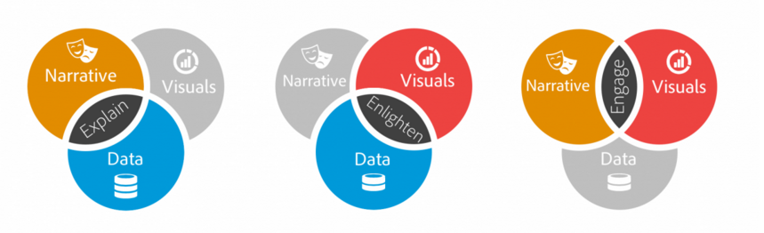
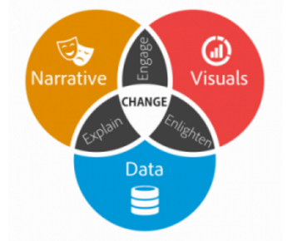
Narrative and context need to accompany visuals
Images: Brendt Dykes, Forbes

Slide 9
Exploration vs. Explanation
Explore – discover or confirm a story that the data is telling you
Take a fresh look at data to see what is interesting
Identify patterns, correlations, outliers, anomaly detection
Keep a clear and open mind
May require additional context
Explain - tell a story
Traditional directed analysis
Must consider audience and message
Visualize
Represents large quantities of data coherently
Does not distort data

Slide 10
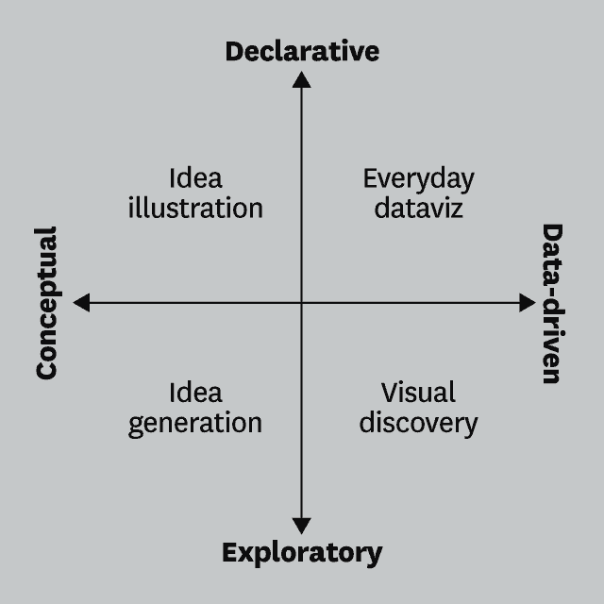
Exploration vs. Explanation, cont’d.
Data Analyst – reporting through dashboards
Interactive – let users explore data
Explain – report on results
vs. Data Scientist
Use exploratory visualization to identify questions / problems / opportunities
Communicate recommendations that lead to decisions driving greater change impact

Slide 11
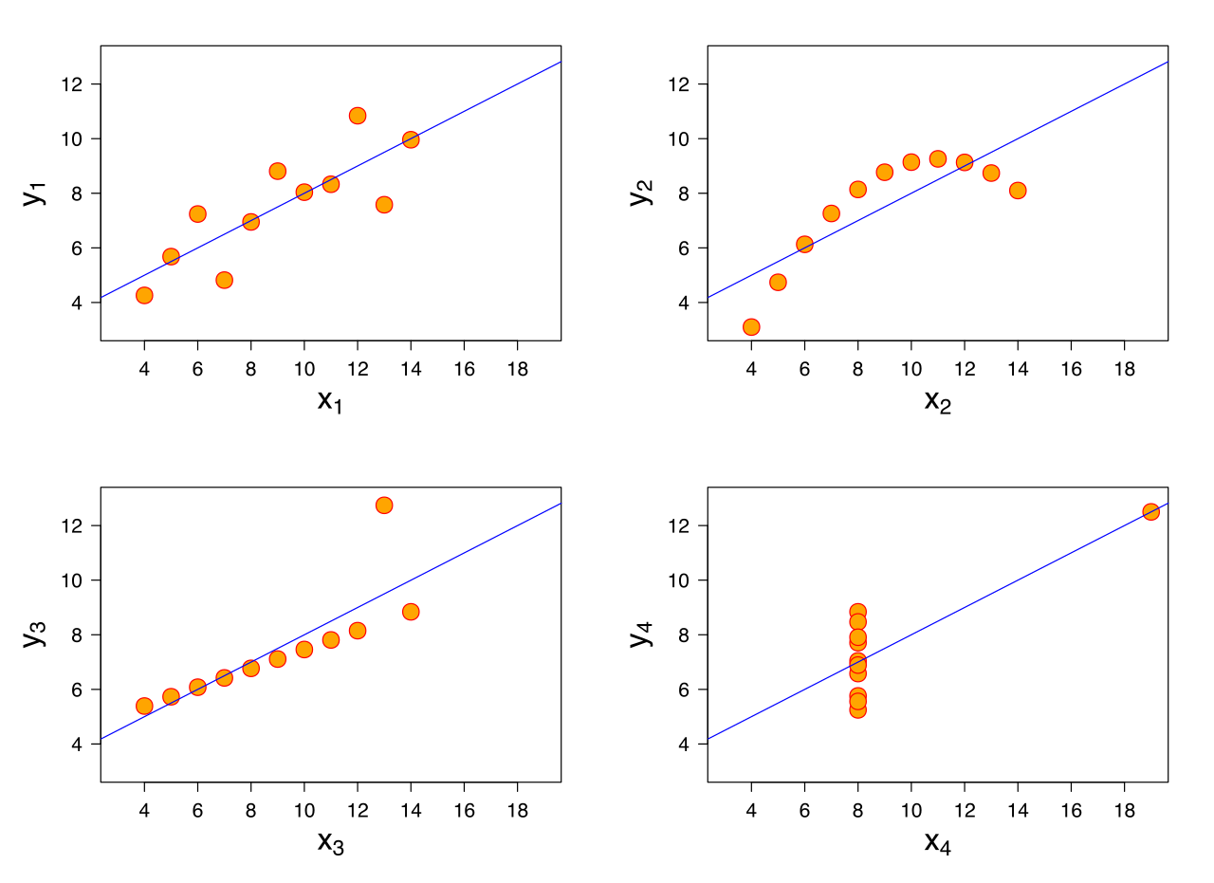
Exploration example: Anscombe’s Quartet (1973)

Slide 12
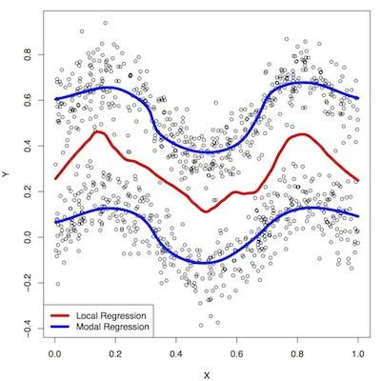
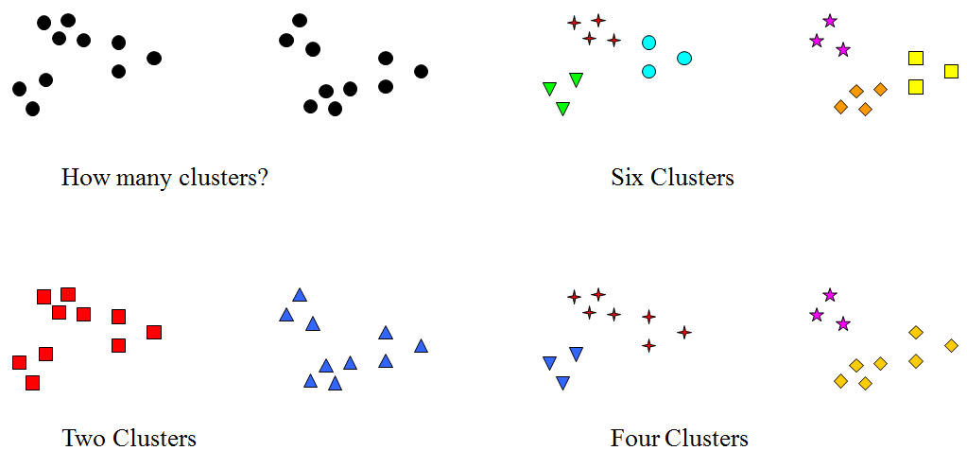
Exploration example: Model selection
Regression: One line, or two??
Clustering: How many clusters?

Slide 13
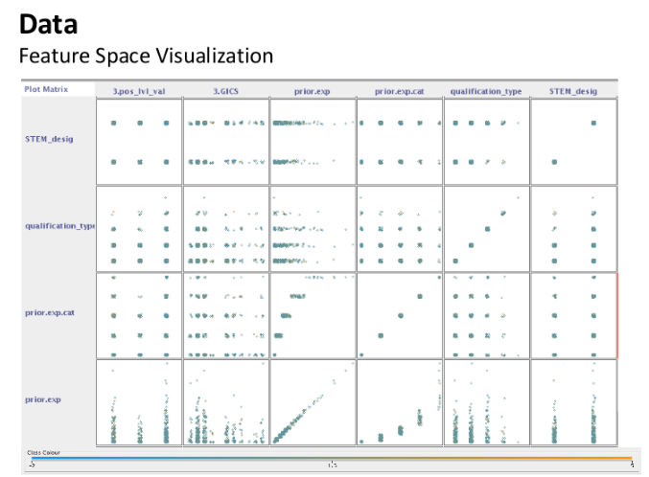
Exploration example: Feature selection
Image credit: Shukri, Louis, Neil, MaGIC Data Science Batch 2

Slide 14
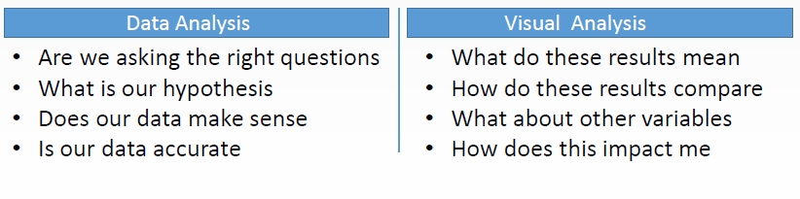
From data analysis to visual analysis
Source: Univ. of Washington

Slide 15
Storytelling
Problem
What are you trying to understand or explain?
Audience
Domain-specific, business vs. technical, CEO vs. practitioner, internal vs. external, private vs. public
Message. What are you trying to communicate? / What is the objective?
Iterative – Business problem and data inform narrative, narrative informs visuals
So what? Conclusions must be meaningful and relevant.
Do my conclusions make sense?
Does the data make sense?

Slide 16
Argumentation
Address your clearly-defined research question / problem statement
Don’t over claim: make assertions based on the data
Take a position: don’t equivocate
Communicate areas of uncertainty / ambiguity
Be up front about the limitations of your analysis
Avoid jargon
Present the main point first, don’t bury the lead
What’s the takeaway?

Slide 17
Presentation flow
Problem statement
Outline topics and objectives of presentation
Key Findings and Significance
Methods
Limitations / Caveats
Conclusions + Next Steps

Slide 18
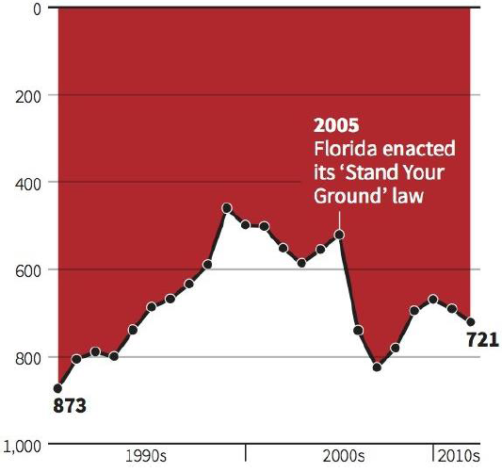
Visualization Common Mistakes
Inverted axis:
Bad data
Inappropriate choice of chart type
Too much data / detail
Wrong scales
Scale clipping (y-axis does not start at 0)
Distorted y-axes suggesting correlation
Inverted axis
Misleading colors
Overenthusiastic use of 3D in charts
Source: Business Insider

Slide 19
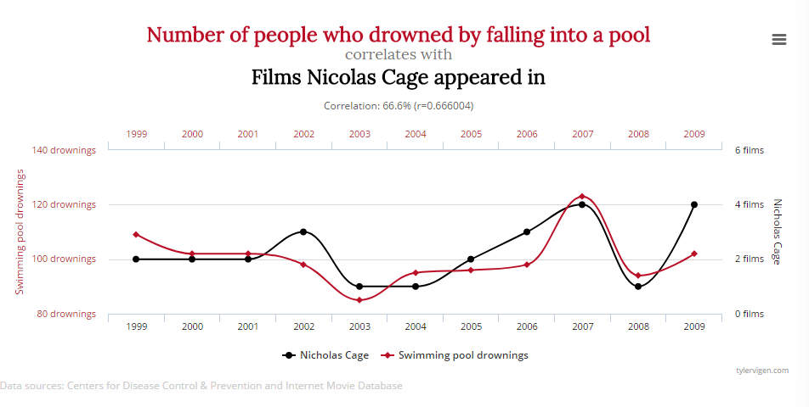
No-no: Manipulating y-axes to suggest correlation
Source: www.tylervigen.com

Slide 20
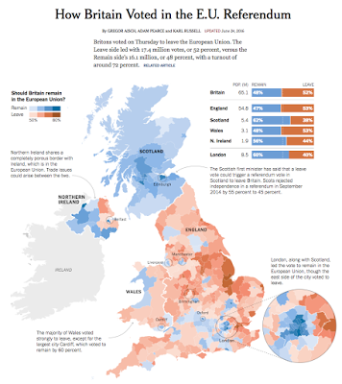
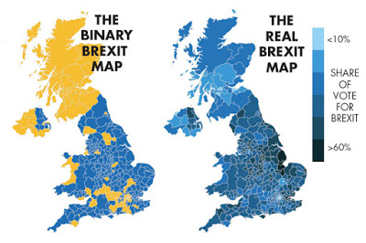
Use appropriate color scaling…

Slide 21
Visualization Best Practices
Stay focused on problem statement, audience, message
Emphasize key takeaways
KISS: less is more
Provide context and visual cues
Minimize text
Flow from big picture summary to details
Don’t mix exploration and explanation
Consistent layout, colors, fonts
Maps are cool ☺ (when appropriate)

Slide 22
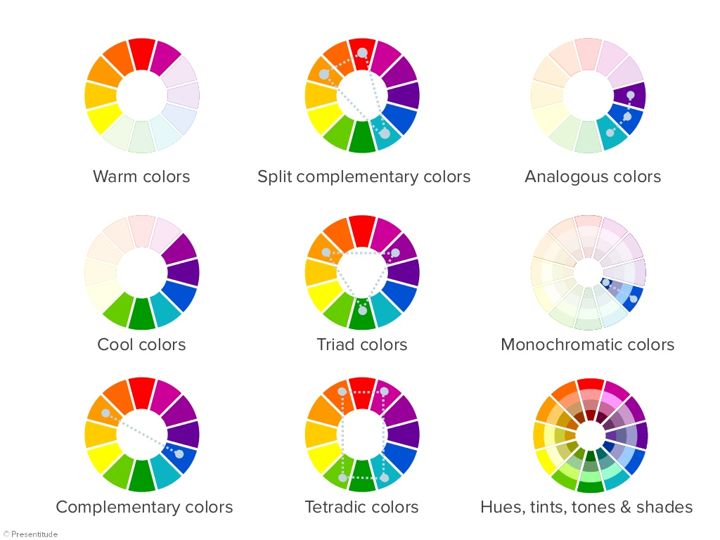
Designing for Perception
Use knowledge of how people perceive images to help design visuals that improve cognition
Design for ease + speed of comprehension, not how ‘cool’ the visual is
Hierarchy of Perception
Color Wheel
Position
Color
Size
Shape
Importance
Notes:
UWDS Slides 27 - 81

Slide 23
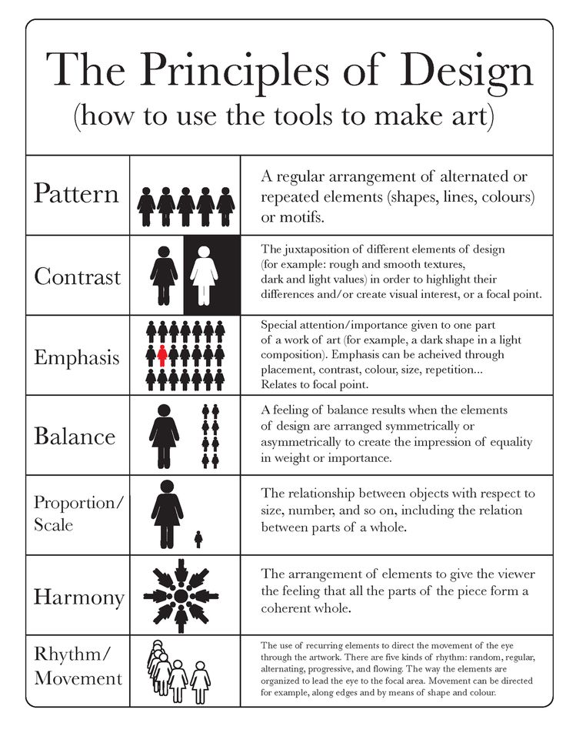
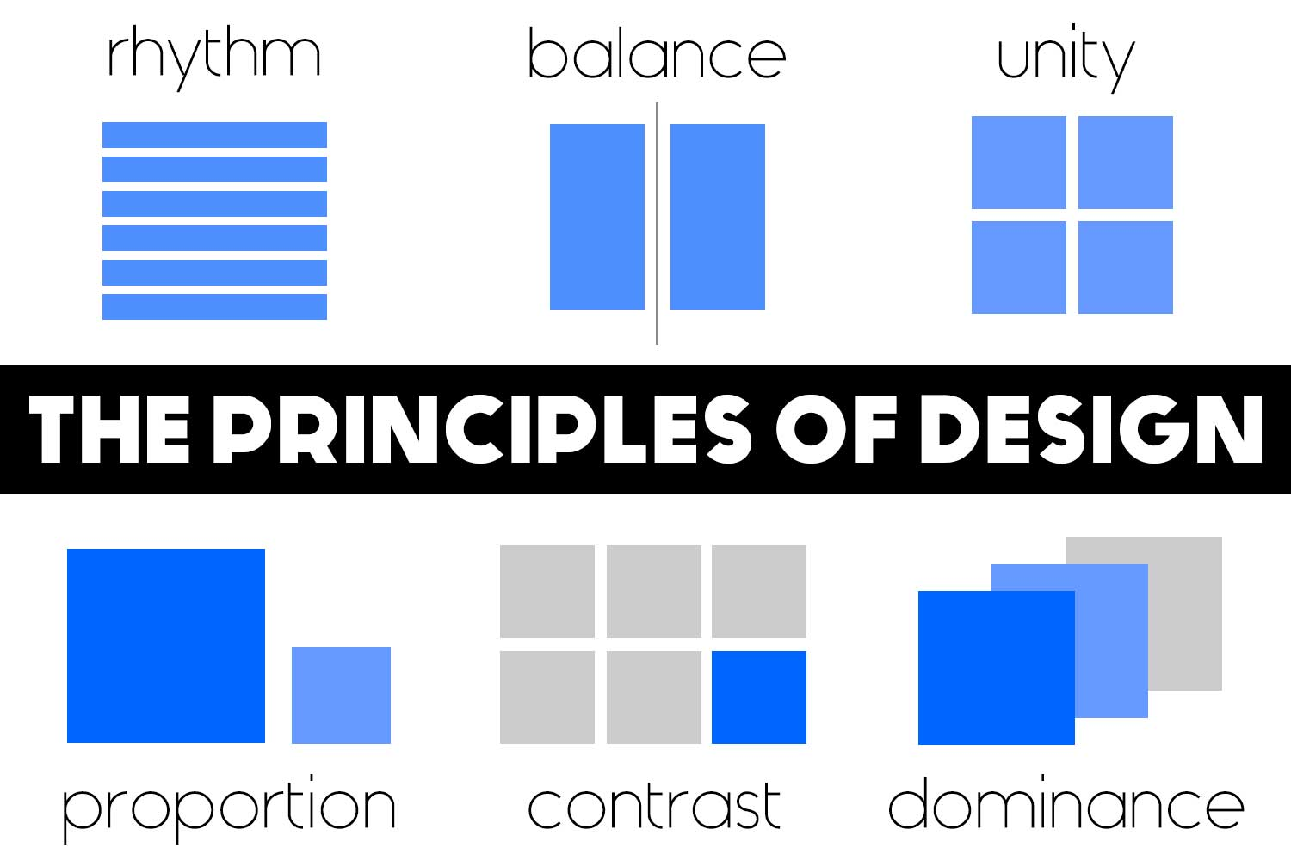
Principles of Design
Notes:
UWDS Slides 27 - 81

Slide 24
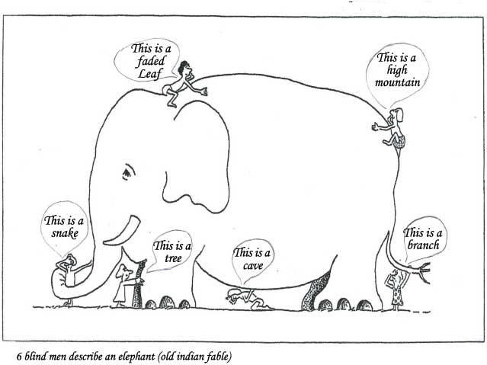

Conception and mental models
Conceptual processing
Perception flows from general to specific
Unconscious influences from expectations, beliefs, biases, and experience.
Interpretation can be altered by motivation
Mental models
Language communicates using definitions and models built from shared experiences, expectations, and context
Mental models allow us to quickly communicate a concept with minimal definition
Need to provide context / prime viewers
Notes:
UWDS Slides 27 - 81

Slide 25
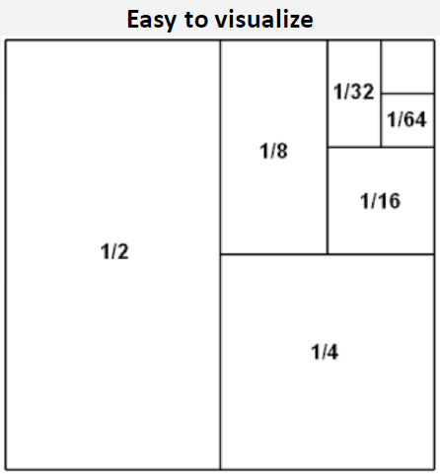
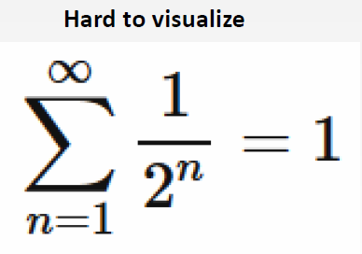
Visualize for comprehension
Source: Univ. of Washington

Slide 26
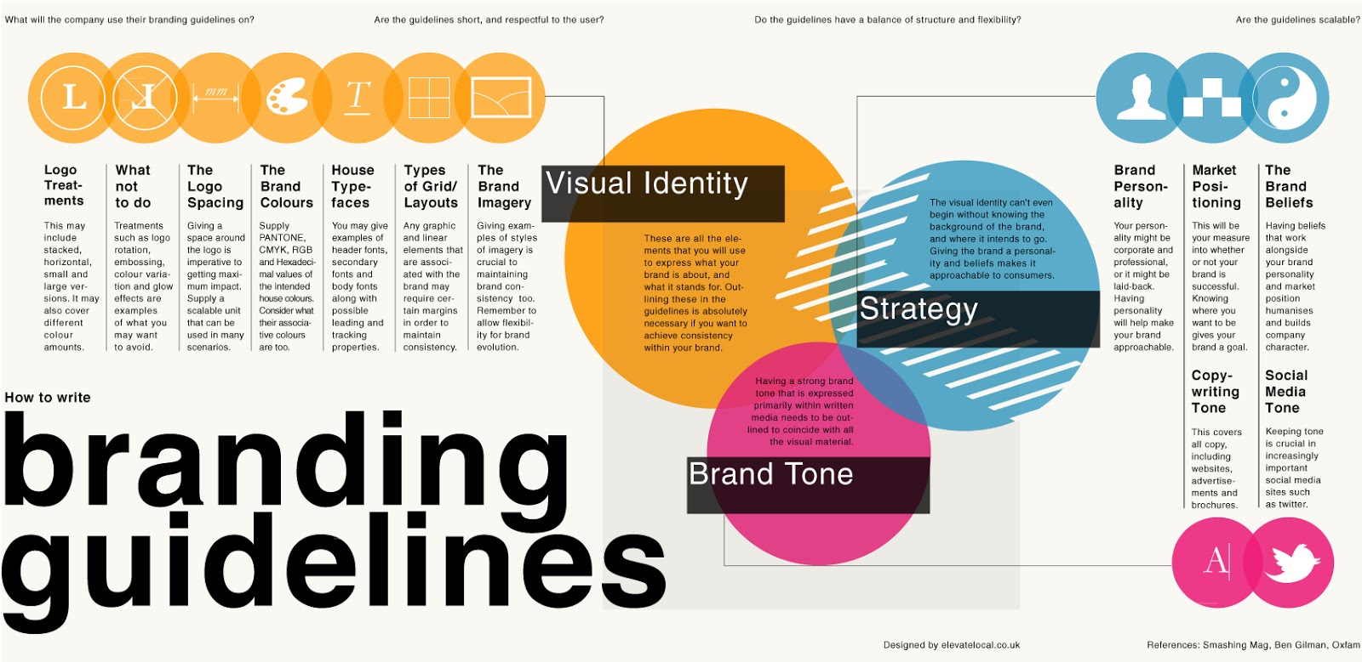
Branding: Consistency, professionalism, emotional connection, association with culture or activity, name recognition
Source: Univ. of Washington

Slide 27
Perception Best Practices
Top-down processing flow: general to specific
Prime viewers to use same mental models
Clean, balanced design helps to convey key takeaways
Strategic use of color: warm/cold colors, red = warning!, color blindness (red/green, combine colors with symbols)
Visual branding: standard color scheme, typography, layout

Slide 28
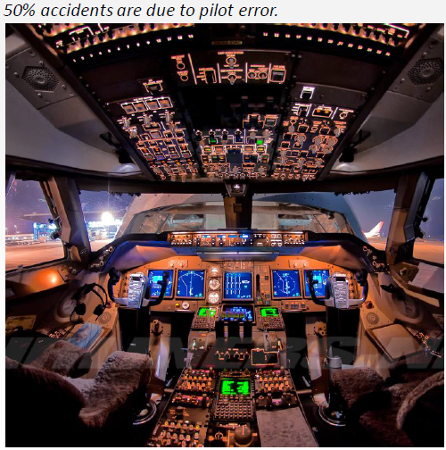
Communicating Complexity
Key performance indicators (KPIs)
Simplify information display: ‘At a Glance’
Priority data – top + center location, large size
Conditional events and alarms
Co-pilot
Share workload
Separate / redundant evaluation
Source: Univ. of Washington

Slide 29
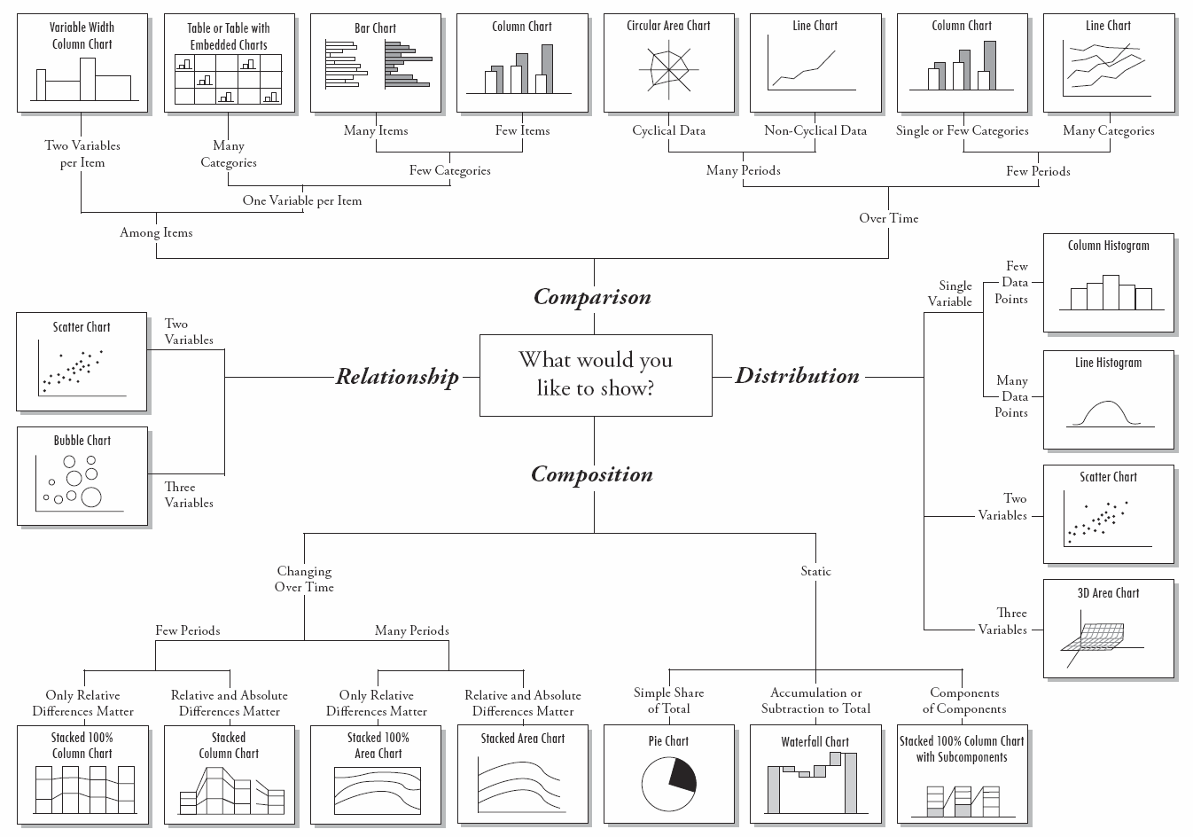
Choosing the right chart type

Slide 30
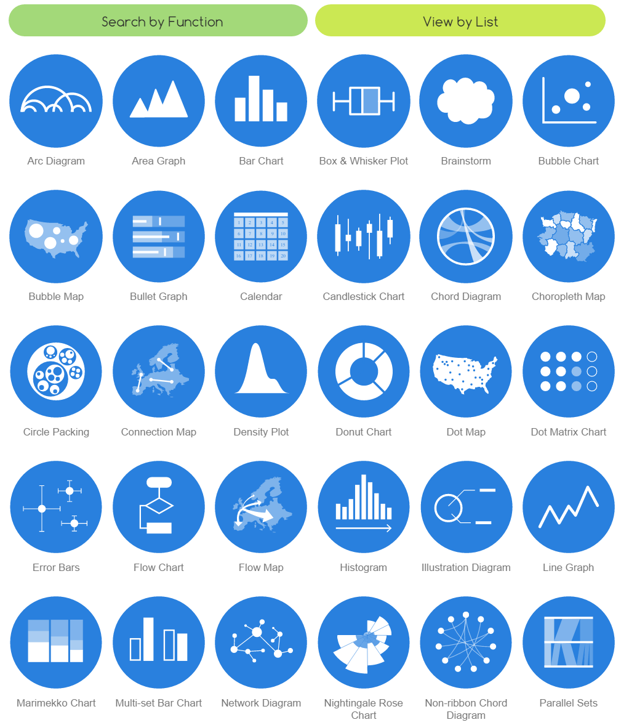
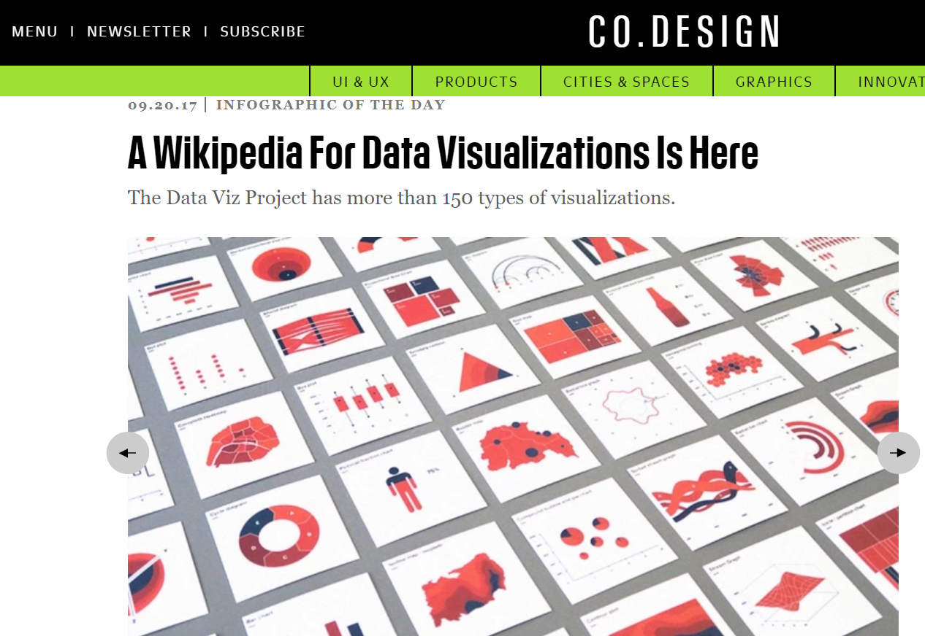
Viz Catalogues
http://www.datavizcatalogue.com/
datavizproject.com

Slide 31
Dashboards
One page view providing ‘at a glance’
Combination of individual visualizations
Can be interactive, but the layout is static / inflexible
Used to communicate strategic, analytical, and operational data
Depict metrics over time or geography
Must include key context for interpretation
Requires up-front investment of time and infrastructure to build
Self-service: empower users to access and explore data (e.g. zoom in/out, change aggregation
Must make easy to use!

Slide 32

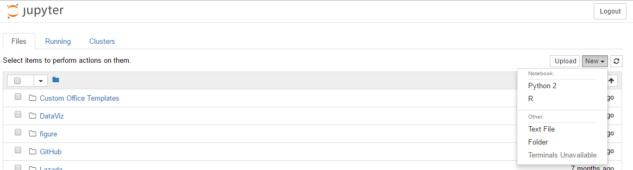
Hands On Exercise: Jupyter Notebook
Install Anaconda (Python 3.6), which includes Jupyter installation
https://www.anaconda.com/download/
Default folder is within Anaconda folder. May need to change start-up folder:
http://jupyter-notebook-beginner-guide.readthedocs.io/en/latest/execute.html
Initialize Jupyter Notebook and create new Python Notebook
Anaconda command prompt:
jupyter notebook

Slide 33
References and Resources
DataViz in Python https://ds8.gitbooks.io/textbook/content/chapters/06/visualization.html
Plotting in Python (Pandas) https://pandas.pydata.org/pandas-docs/stable/visualization.html
Visualizations in Python https://github.com/neurohackweek/visualization-in-python/blob/master/visualization-in-python.ipynb
http://slides.com/yahwes/data-vis
http://www.datavizcatalogue.com/
http://www.datavizproject.com
University of Washington, Intro to Data Science (DS250) Lecture, “Communicating with Data”
https://www.perceptualedge.com/blog/?p=1829
DataViz in R http://r4ds.had.co.nz/data-visualisation.html

Slide 34
Open Data Sources
Government data - Data.gov.my, Data.gov, Socrata, Sinar Project
http://googletrends.github.io/data/
http://datausa.io/
Research Data - re3data.org
World’s event data - Gdeltproject
API sources - Programmable Web
World Statistics - http://knoema.com/
Amazon AWS public datasets
DataHub
KDnuggets
Kaggle Datasets

Slide 35

Questions?
Nadav Rindler
nrindler@gmail.com
https://www.linkedin.com/in/nrindler/

